Slide 1
Power Sector Resilience Solutions
Power Sector Resilience Planning Guidebook
The following slides are intended to provide additional background information on the entire power sector resilience planning process, including examples of solutions and how to prioritize them. They can serve simply as a reference or can be used in local power sector resilience assessment workshops. For questions or more information on the slides, use the “Ask An Expert” feature on the Resilient Energy Platform website.

Slide 2
Key Messages
Resilience is more than just reliability
Resilience planning should be part of integrated planning
There are multiple ways to prioritize resilience action:
Priority threats
Cost
Difficulty
Number/priority of enhanced systems
Cascading Impacts
Ancillary benefits
Benefits to power system resilience:
Ability to reliably meet growing electricity demands
Decreased dependence on imported fuels, diversification of resources
Less economic loss/impact from threats
Improved infrastructure for fuel supply and electricity transmission
Increased safety and decreased mortality rates

Slide 3
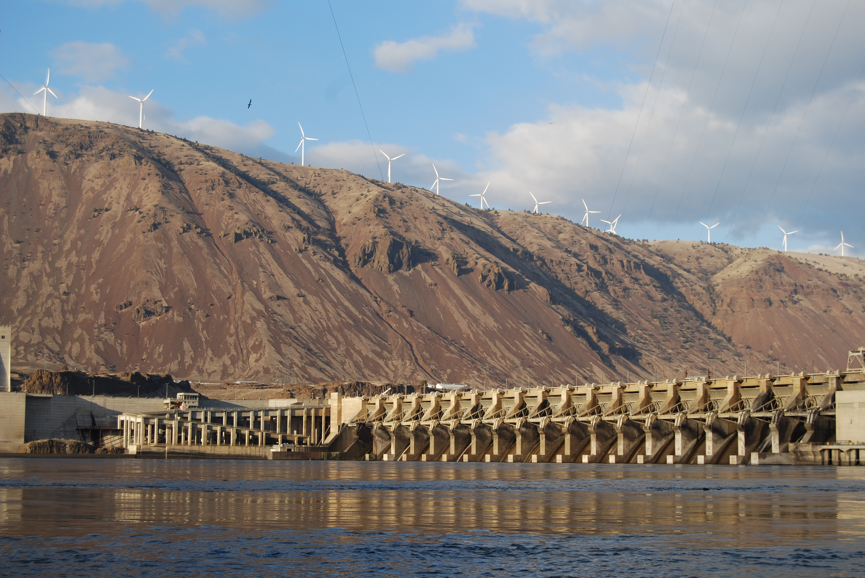
What Do We Mean by Resilience?
Power sector resilience refers to the ability of the power sector to anticipate, prepare for, and adapt to changing conditions and withstand, respond to, and recover rapidly from disruptions.¹
Utilities often speak about resilience in terms of reliability.
In reality, resilience encompasses more topics:
Economic resilience
Readiness for climatic changes
Operational flexibility
Ability to shift resources should also be considered
Figure. MWH Global
1. NREL’s Resilience Roadmap: https://www.nrel.gov/resilience-planning-roadmap/

Slide 4
Resilience Planning Process Review

Slide 5
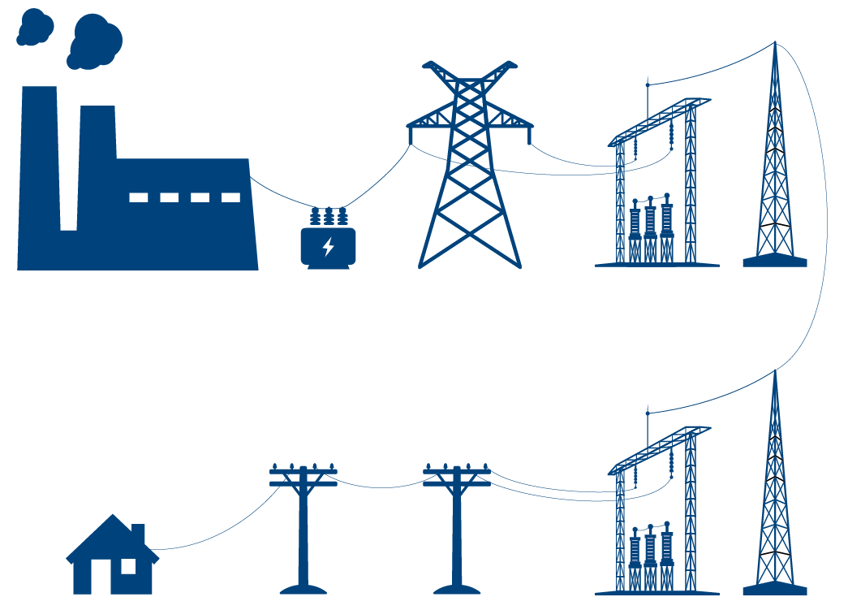
Power Sector Threats to Consider
Threats to power systems include:
Climate threats
Price volatility of generation fuel
Variability of renewable energy resources
Technology failures (such as dam collapses)
Human actions including accidents and attacks
Operations
Power Plant
Step-up transformer
Transmission
Transmission Substation
Workforce
Load
Distribution
Distribution Substation
Finance
Community impacts related to power-supply vulnerabilities include:
Critical facility outages
Health impacts of power outages
Social and financial impacts of power outages

Slide 6
Economic Impacts of Power Outages
In the U. S., Cost estimates from storm-related outages to the economy are estimated at between $20 billion and $55 billion annually.
Industries most impacted by outages:
Digital economy (telecommunications, data storage and retrieval services, the financial industry, etc.)
Continuous process manufacturing (e.g. paper, chemicals, petroleum, rubber and plastic, etc.)
Essential services (e.g. hospitals, utilities and transportation facilities such as railroads and mass transit, water and wastewater treatment, gas utilities and pipelines, etc.)
Source: ttp://woodpoles.org/portals/2/documents/CRS_Outages.pdf
Notes:
The digital economy (DE). This sector includes firms that rely heavily on data storage and retrieval, data processing, or research and development operations. Specific industries include telecommunications, data storage and retrieval services (including collocation facilities or Internet hotels), biotechnology, electronics manufacturing, and the financial industry. Continuous process manufacturing (CPM). This sector includes manufacturing facilities that continuously feed raw materials, often at high temperatures, through an industrial process. Specific industries include paper; chemicals; petroleum; rubber and plastic; stone, clay, and glass; and primary metals. Fabrication and essential services (FES). This sector includes all other manufacturing industries, plus utilities and transportation facilities such as railroads and mass transit, water and wastewater treatment, and gas utilities and pipelines.

Slide 7
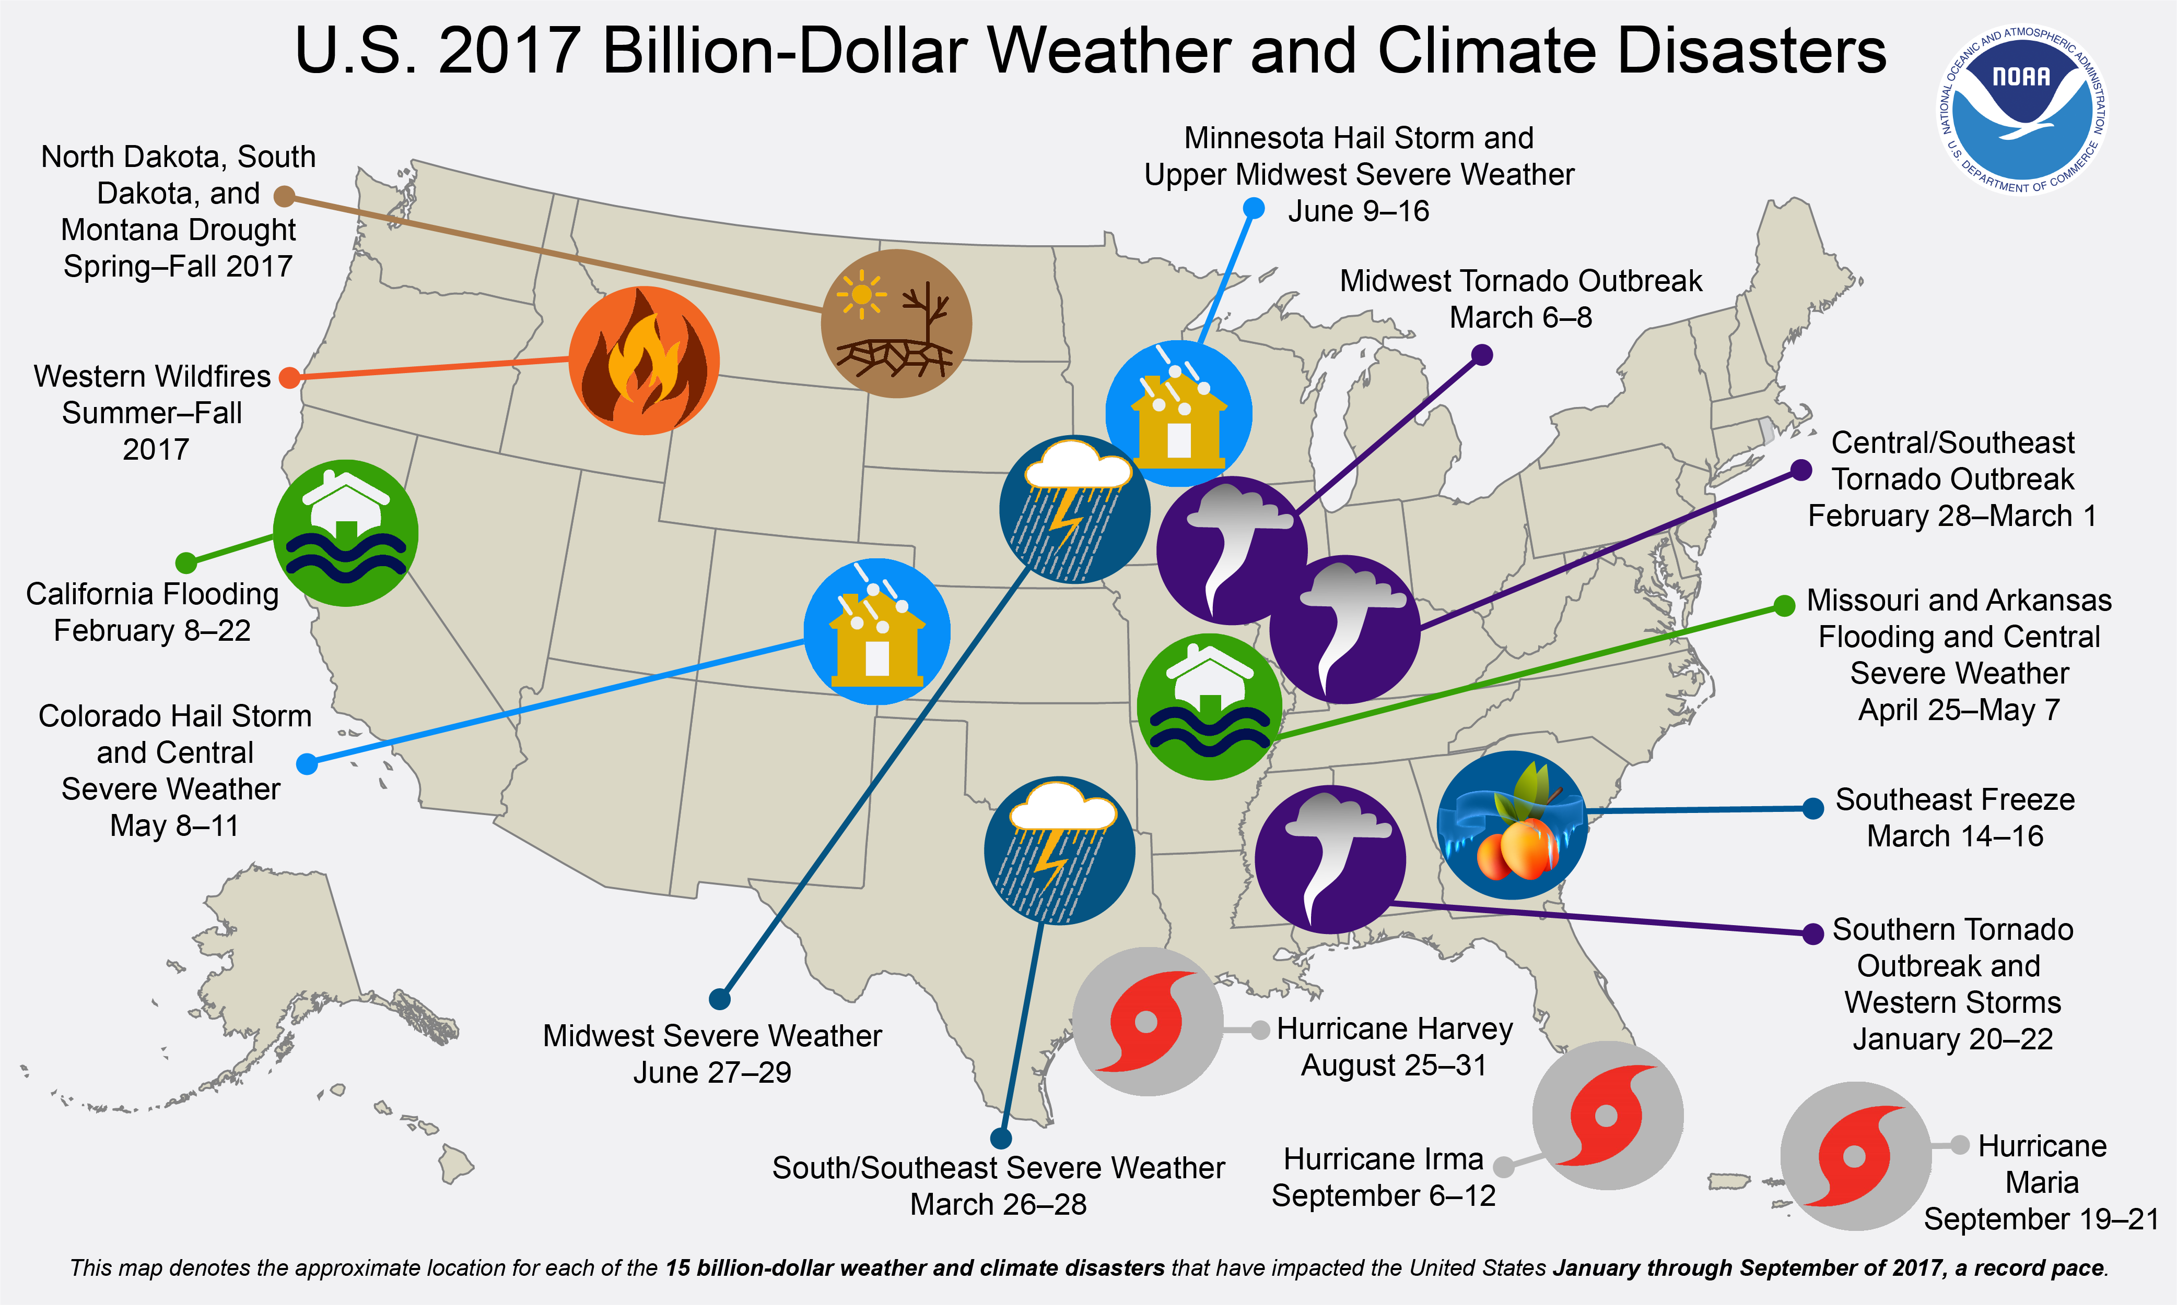
Economic Impacts of Power Outages
Source. NOAA NCEI, https://www.climate.gov/news-features/blogs/beyond-data/2017-us-billion-dollar-weather-and-climate-disasters-historic-year

Slide 8
Economic Impacts of Power Outages
Example: Pakistan
Pakistan ranks 115th out of 137 countries for grid reliability
50 million Pakistanis lack access to reliable electricity
Cost estimates from storm-related outages to the Pakistani economy are estimated at $18 billion annually, 7% of their GDP.
Source. Zhang, 2019, In the Dark: How Much Do Power Sector Distortions Cost South Asia
The World Bank
Notes:
The digital economy (DE). This sector includes firms that rely heavily on data storage and retrieval, data processing, or research and development operations. Specific industries include telecommunications, data storage and retrieval services (including collocation facilities or Internet hotels), biotechnology, electronics manufacturing, and the financial industry. Continuous process manufacturing (CPM). This sector includes manufacturing facilities that continuously feed raw materials, often at high temperatures, through an industrial process. Specific industries include paper; chemicals; petroleum; rubber and plastic; stone, clay, and glass; and primary metals. Fabrication and essential services (FES). This sector includes all other manufacturing industries, plus utilities and transportation facilities such as railroads and mass transit, water and wastewater treatment, and gas utilities and pipelines.

Slide 9
Resilience Planning Process

Slide 10
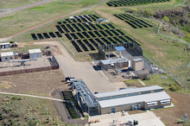
Example Resilience Solutions
Supply chain assurance
Spatial diversification
Generation mix diversification
Islandable energy systems for critical loads (microgrids)
Critical load panels in emergency facilities
Passive survivability
Load shedding
Energy storage
Hardening infrastructure
Underground distribution lines
Fortifying transmission lines
Raising substations
Photos. Dennis Schroeder, NREL

Slide 11
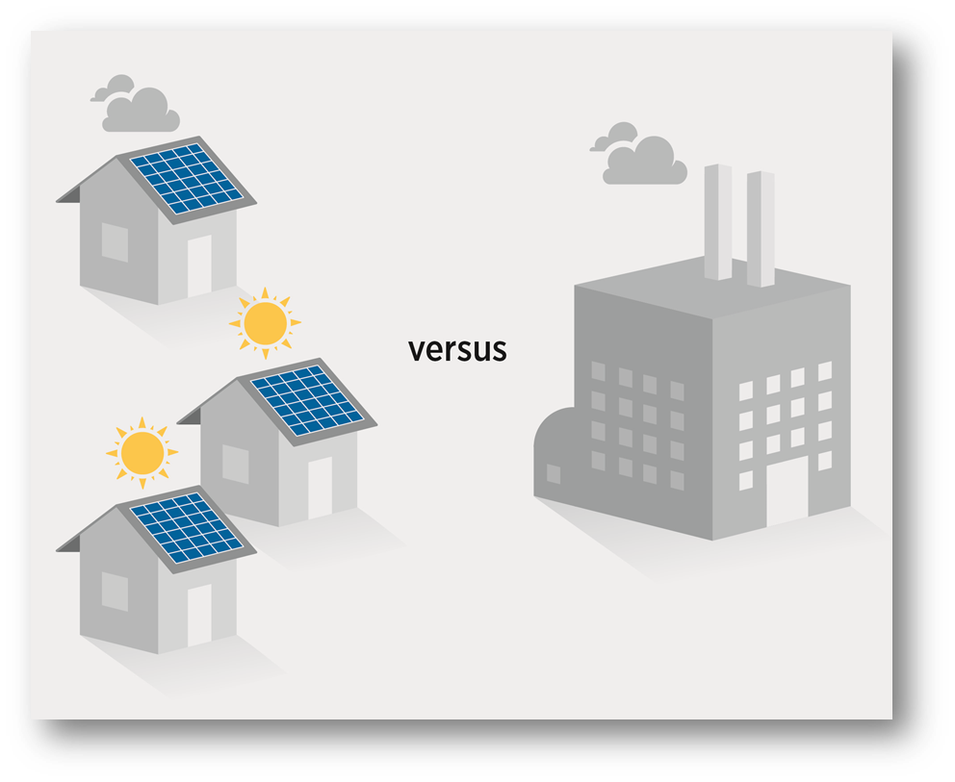
Resilience Solution: Spatial and Generation Diversification
The modular (or sectional) nature of renewable energy technologies, such as wind turbines and solar photovoltaics (PV) allows:
Greater spatial diversification of energy supplies compared to conventional power generation systems
Increased diversification of energy mix compared to single fuel conventional power plants
Increased diversification reduces the vulnerability of the energy supply system and the probability of an event to damage the larger system or critical locations, which increases overall energy system resilience
Figure. Stout et al., 2018)

Slide 12
Resilience Solution: Microgrids
Distributed generation (DG) based microgrids capable of islanding can disconnect from the central grid during an outage event to allow energy to be diverted to critical loads.
Allows utilities flexibility in restoring generation stations, responding to critical outages, and shutting down systems before an anticipated major event (like storms) to prevent damage.
Islanded DG systems ensure consumers have access to power during long-term power outages that severely impact central grid systems, which can occur after major events.
Additional Benefit: microgrids can participate in demand response programs to reduce electric loads during times of peak demand.

Slide 13
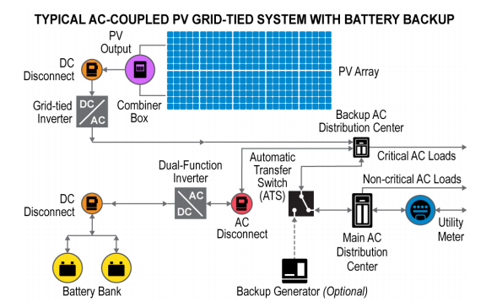
Resilience Solution: Microgrids
Figure. https://nysolarmap.com/media/1655/dghubresiliencyretrofitfactsheet_8_8_16.pdf

Slide 14
Resilience Solution: Redundancy
Redundancy is the inclusion of additional resources beyond those that are required for daily operations that can be relied upon in case of failure in other components.
The increased stress on infrastructure systems can increase the likelihood of failure of one or more parts of a system.
Redundancy is essential for resilience. Renewable DG can add redundancy while stretching fuel supplies for conventional generators
Communities served by only one power line or generating station have limited resilience. Increasing supplies, routes, or incorporating redundancy to overall systems will reduce the risks of those systems.

Slide 15
Resilience Solution: Redundancy
Figure. Anderson et al. 2016

Slide 16
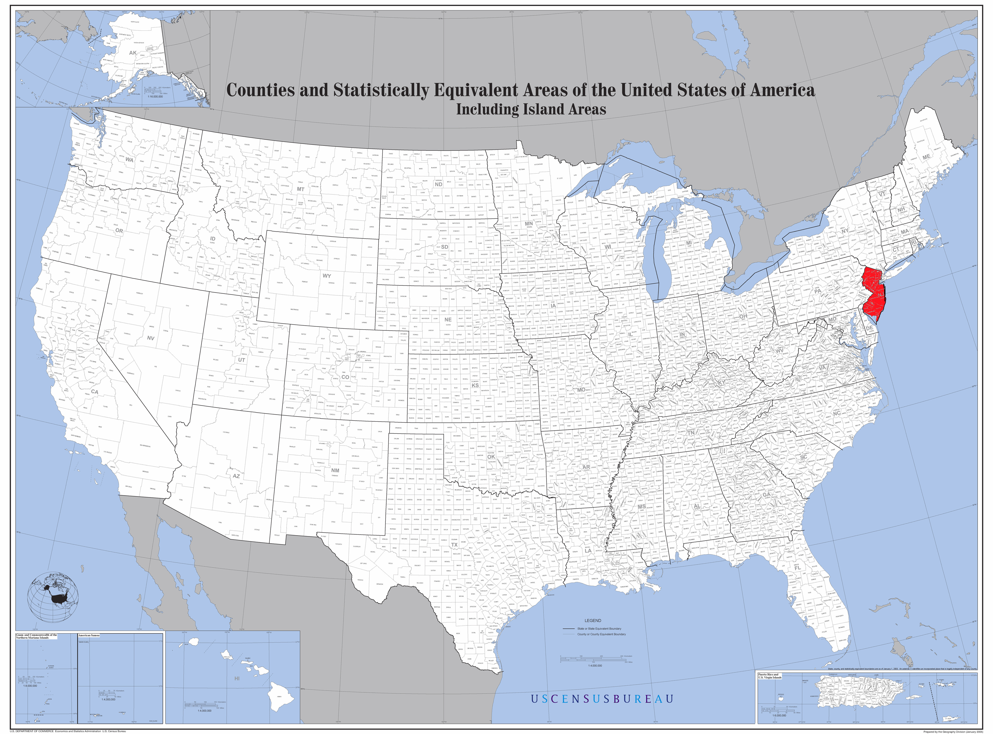
Resilience Solution: Policy
In 2012 the U.S. state of New Jersey had the second most installed solar PV of any U.S. state.
When Hurricane Sandy hit, only a few of those systems provided power during the 12 day ensuing power outage.
Why?
Lack of resilience enabling policy, interconnection agreements, and island controls!
Figure. https://en.wikipedia.org/wiki/File:Map_of_the_USA_highlighting_New_Jersey.png

Slide 17
Resilience Planning Process

Slide 18
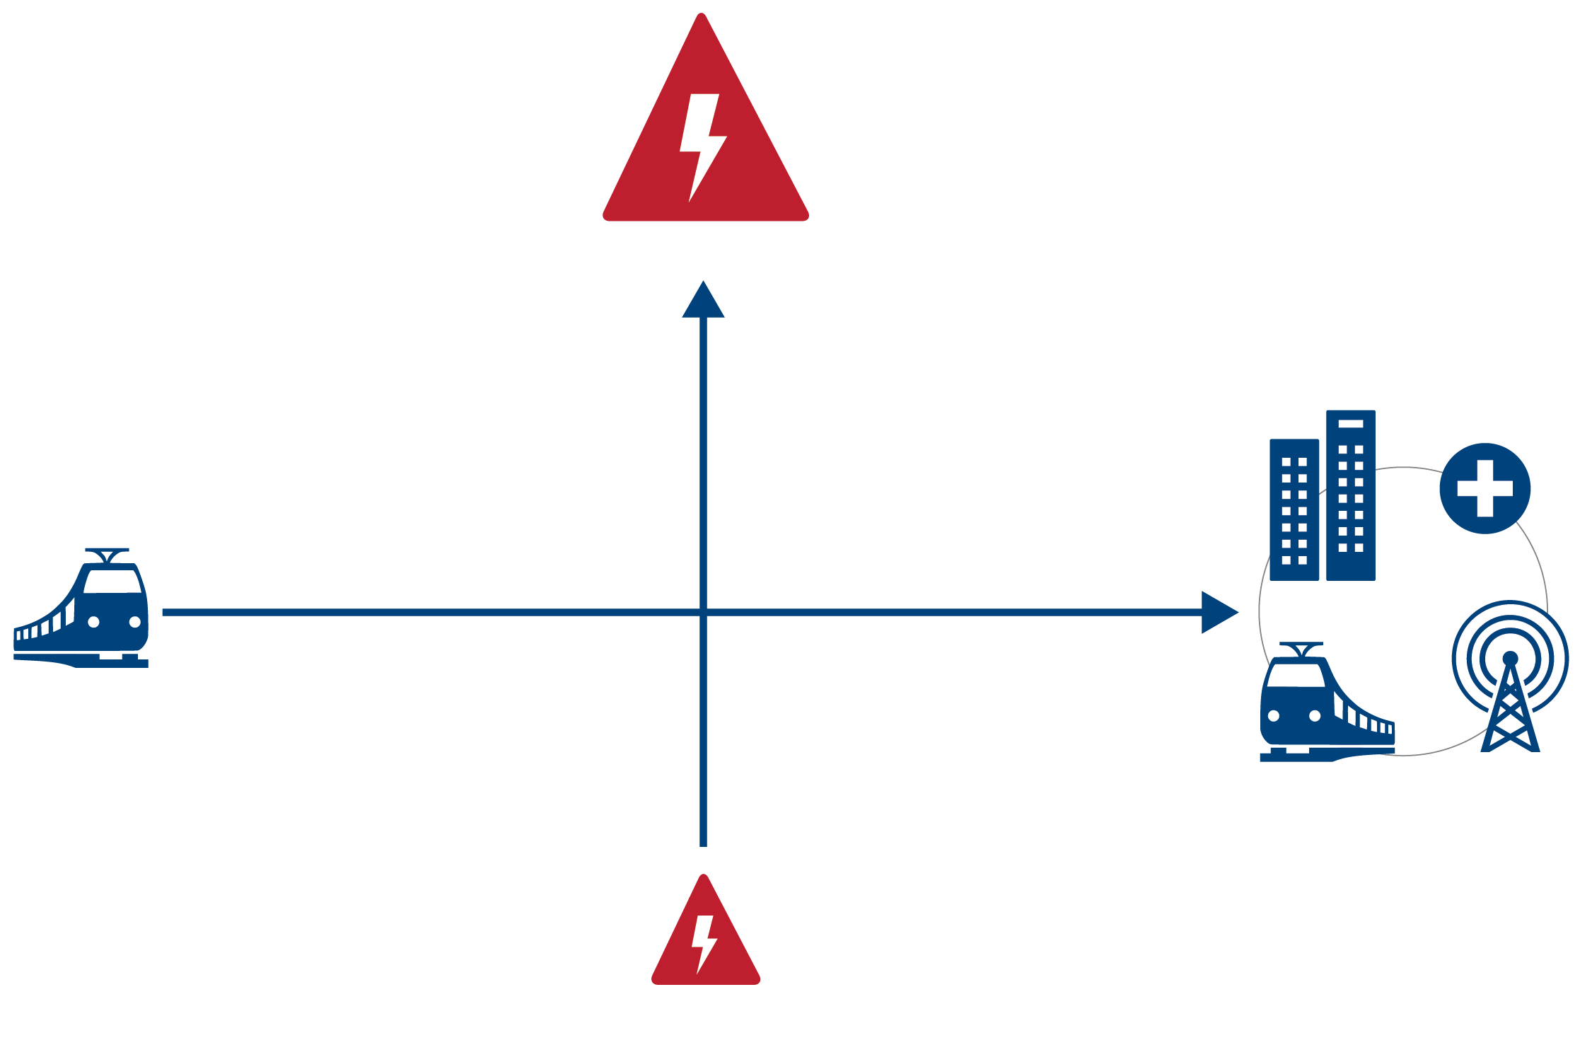
Resilience Planning: Options Evaluation by Priority Vulnerabilities
High probability threat with regional impact
Single system impacts
Multiple system impacts
Low probability threat with limited impact

Slide 19
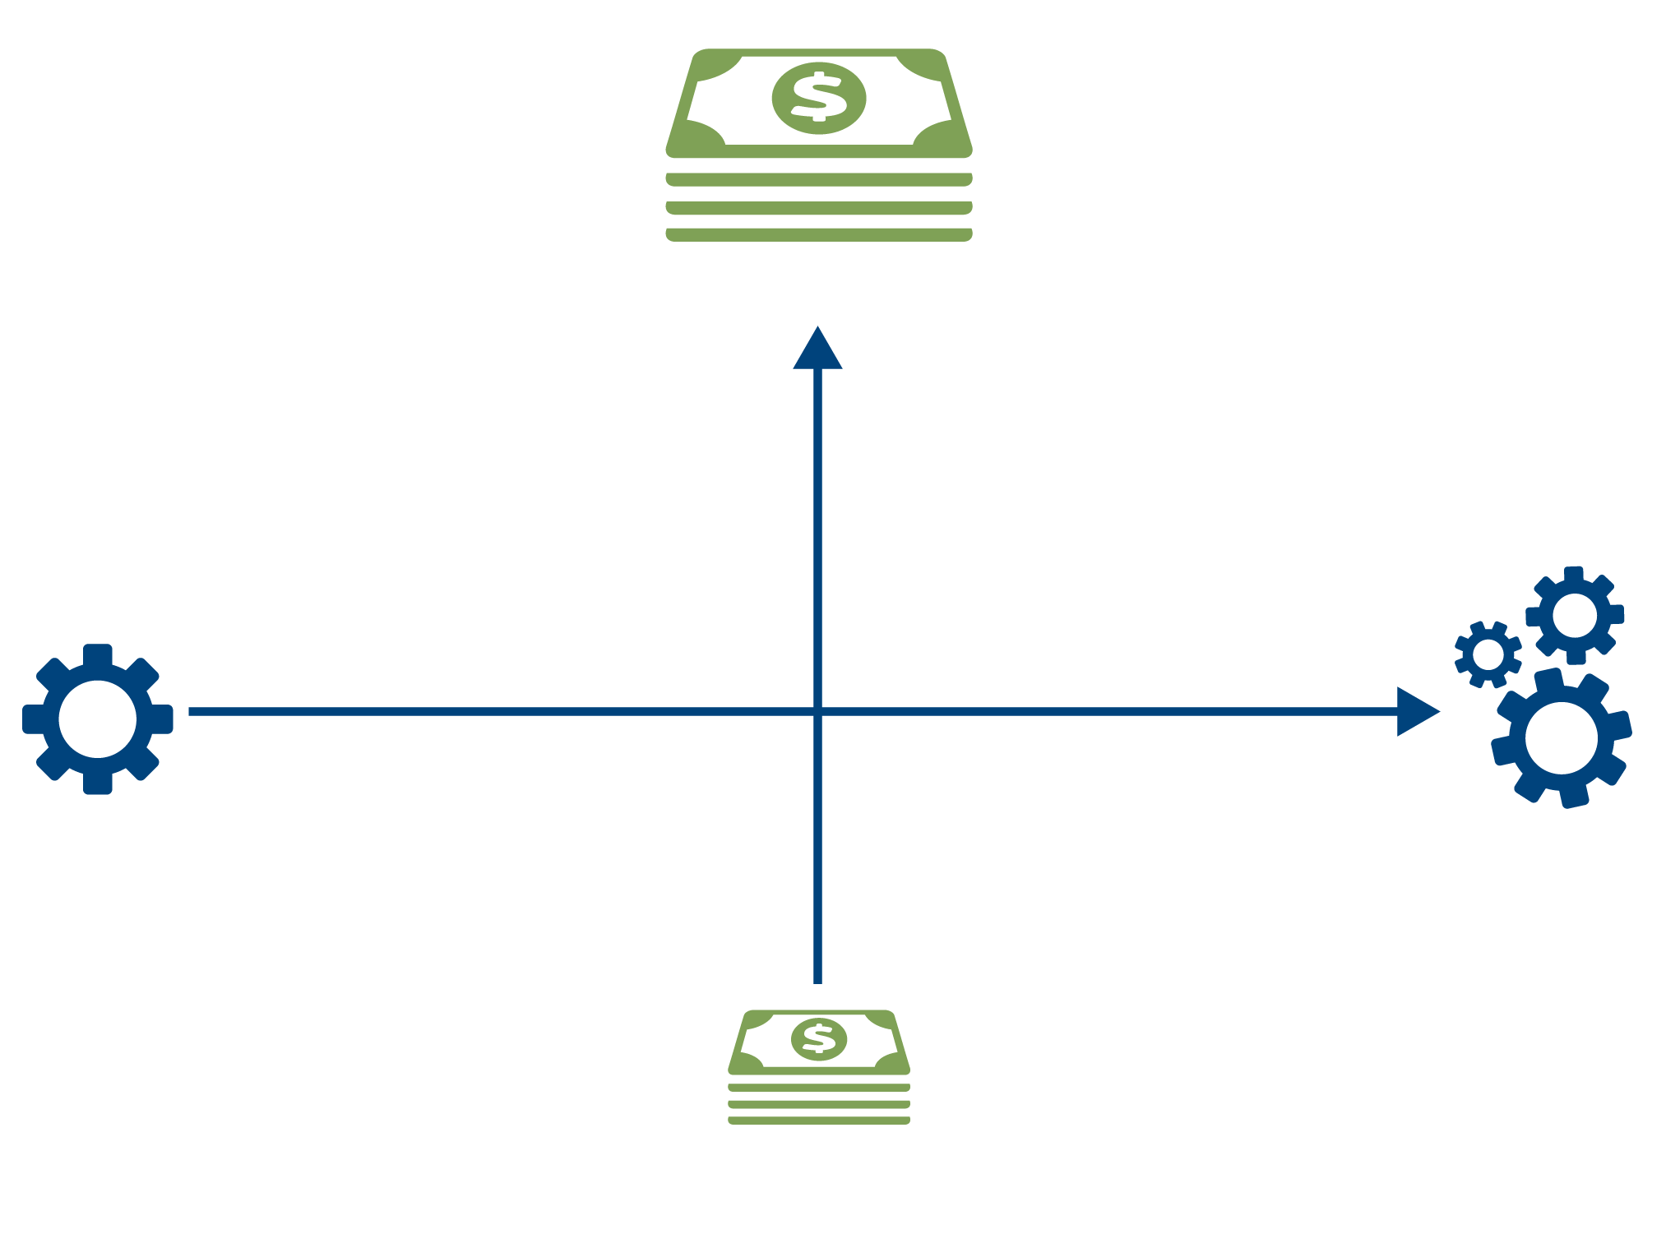
Resilience Planning: Options Evaluation by Cost and Complexity
High cost of implementation
Simple implementation
Complex implementation
Low cost of implementation

Slide 20
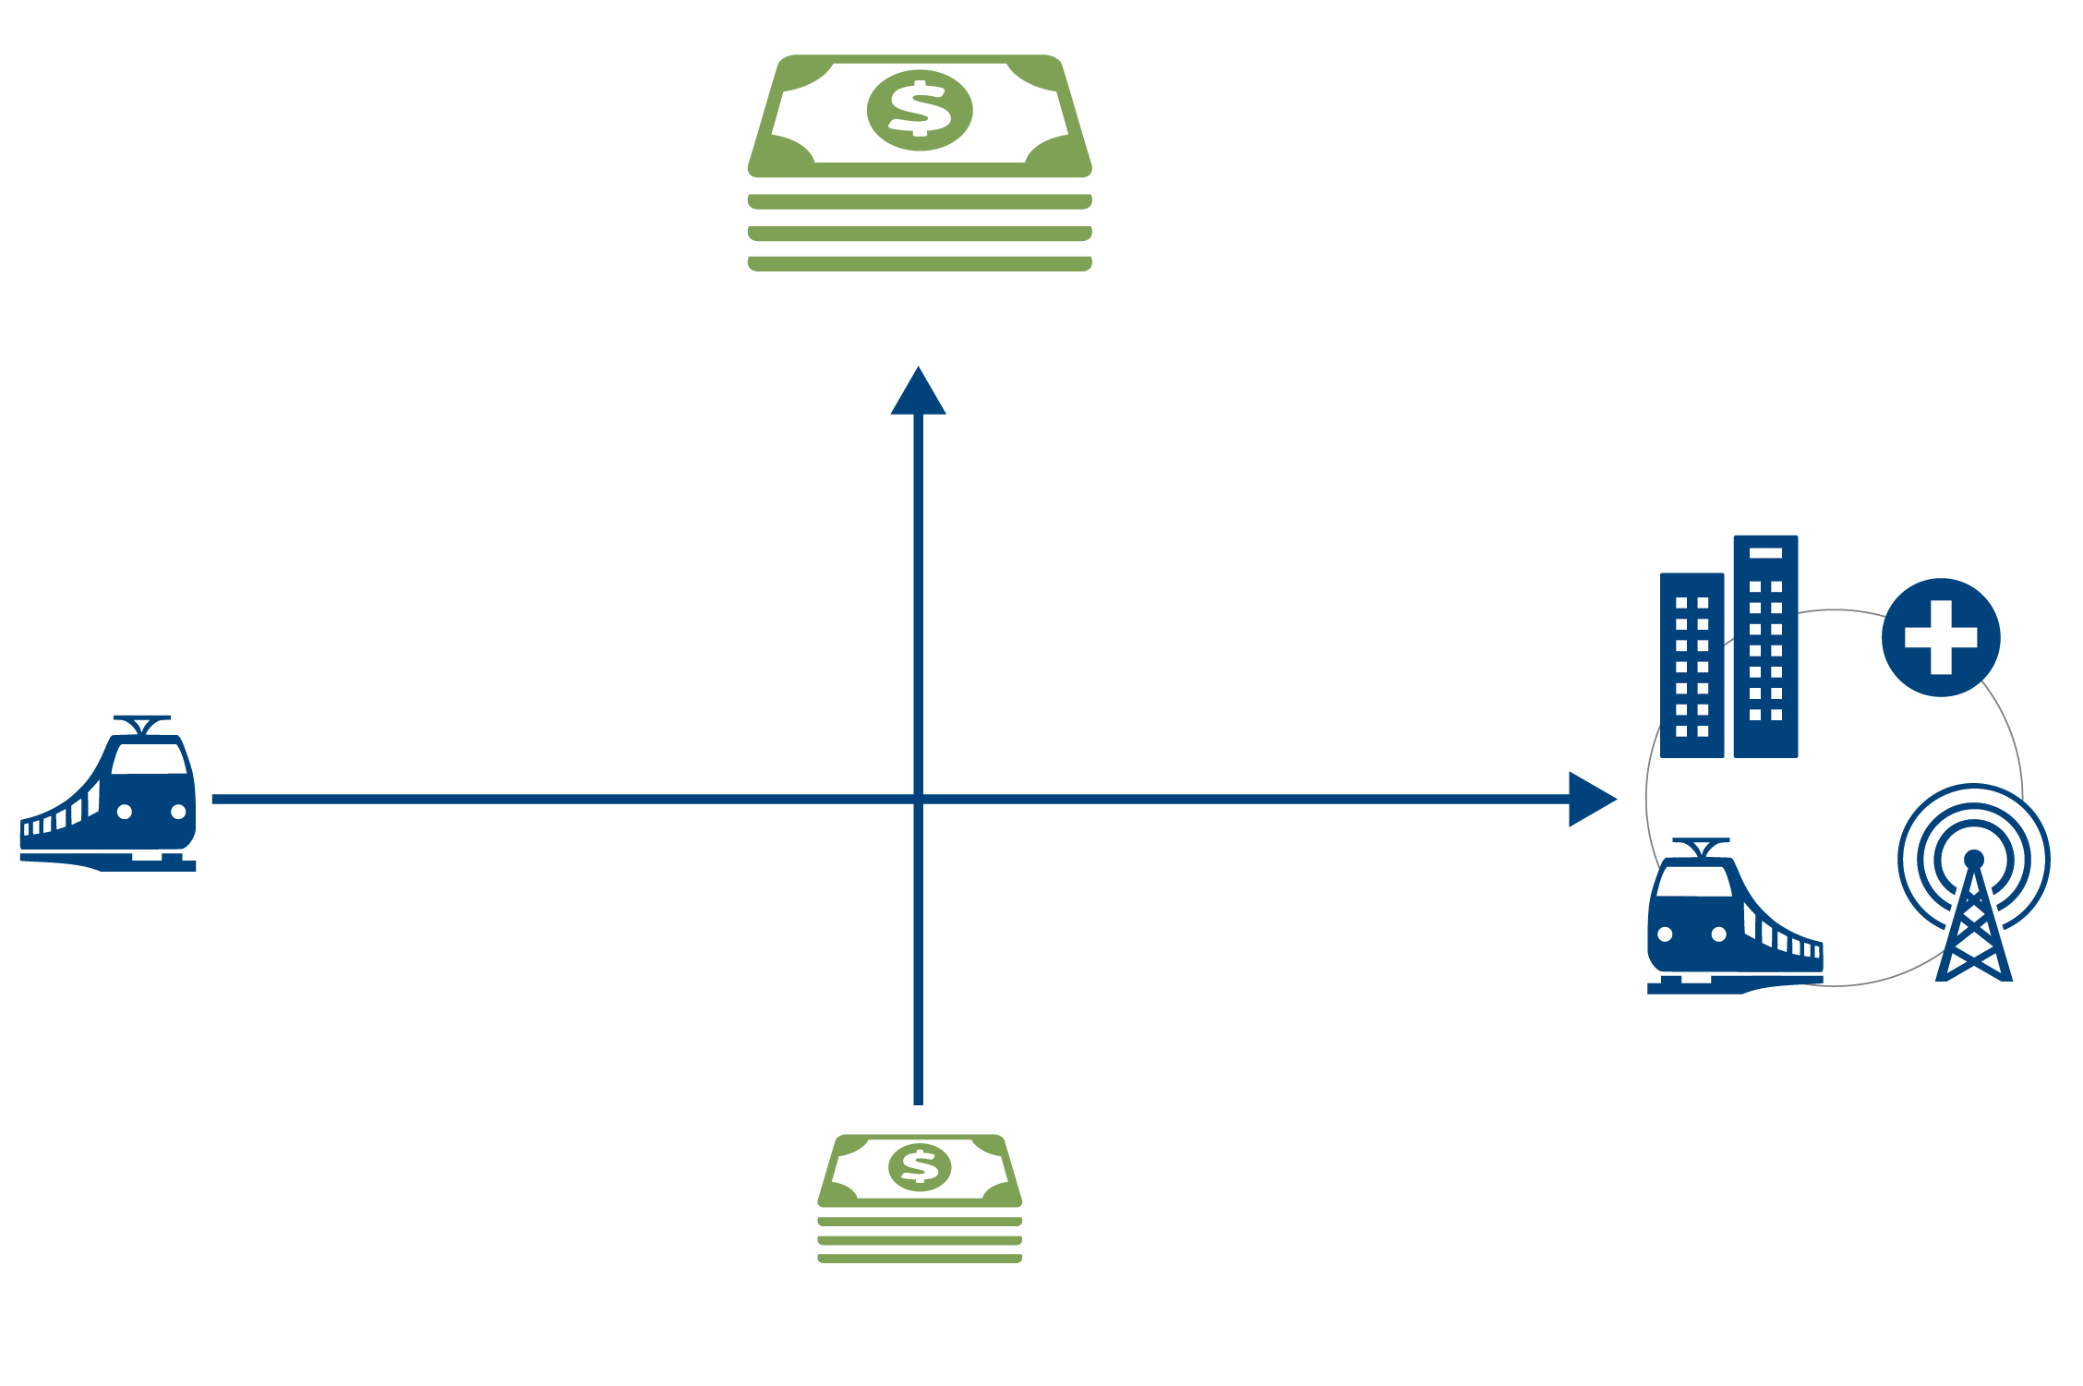
Resilience Planning: Options Evaluation by Cost and Priority Systems
High cost of implementation
Single system impacts
Multiple system impacts
Low cost of implementation

Slide 21
Effective Resilience Planning:
Power sector resilience planning should:
Be incorporated into existing planning processes
Include engagement with non-utility entities for incorporation into broader community resilience and adaptation planning
Be part of a process that is revisited and updated periodically
Be incorporated into an action plan for implementation and financing will need to be identified to support project implementation

Slide 22
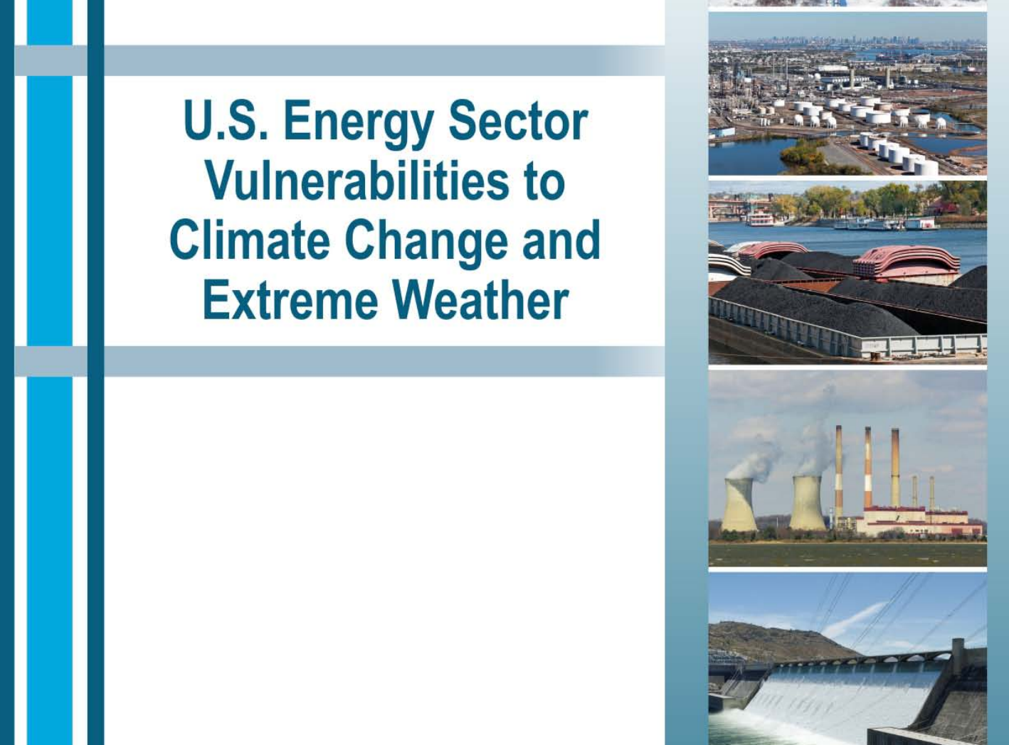
Early Actions for Resilience
Update resilience enabling policies
Are energy systems allowed to island? How much fuel must you store?
Define current and projected threats
How many floods do you have now? How many floods will you have in 2050?
Set resilience goals
Ability to fully re-power within 3 days of major weather event, 10% DG + storage by 2025, all substations above projected flood height by 2020
Define critical facilities and services
Figure. https://www.energy.gov/downloads/us-energy-sector-vulnerabilities-climate-change-and-extreme-weather

Slide 23
Key Takeaways
Redundancy and diversification are key to increasing power sector resilience.
Renewable energy can play a valuable role in power sector resilience through redundancy and energy diversification.
Policy matters! Don’t forget to incorporate good policy design into technical adaptation strategies
Include resilience planning as part of larger integrated planning processes.
Resilience planning is iterative. Plans have to evolve as contexts and threats change

Slide 24
Useful Links
Resilience Roadmap https://www.nrel.gov/resilience-planning-roadmap/
Reopt Model https://reopt.nrel.gov/
New York Solar Smart DG Hub Resilient Solar Project: https://www.nrel.gov/docs/fy16osti/66617.pdf
Distributed Solar PV for Electricity System Resiliency: Policy and Regulatory Considerations https://www.nrel.gov/docs/fy15osti/62631.pdf
Microgrid-Ready Solar PV - Planning for Resiliency https://www.nrel.gov/docs/fy18osti/70122.pdf
Distributed Generation to Support Development Focused Climate Action https://www.nrel.gov/docs/fy16osti/66597.pdf
NY Solar Smart Glossary https://nysolarmap.com/media/1457/dg_hub_glossary.pdf

